Slide 1
Machine Learning on Tracking Data with 3D Slicer
Matthew S. Holden
School of Computer Science
Carleton University
matthew.holden@carleton.ca

Slide 2
Machine Learning for Time Series
Action recognition & segmentation
Time series classification
Time series forecasting
?
?
?

Slide 3
Why Tracking Data?
More accurate than with imaging data.
Models are faster to train.
Measures different characteristics of an intervention.

Slide 4

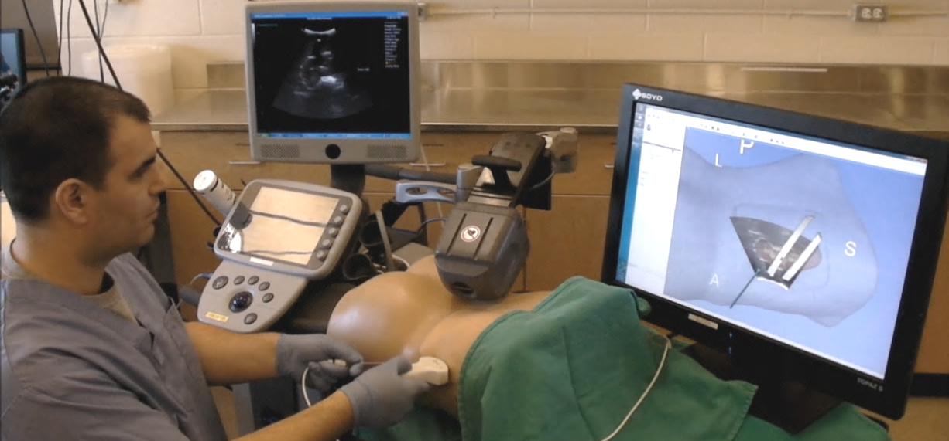
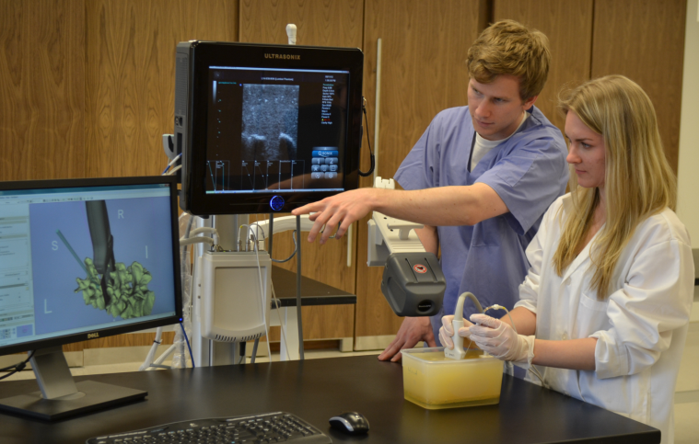
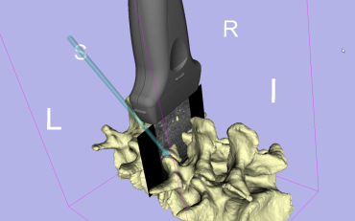
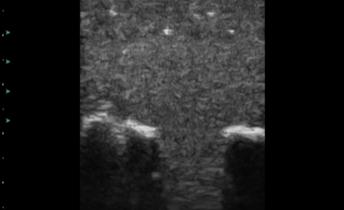
Perk Tutor
www.perktutor.org
Open-source surgical training platform
Data collection
Skills assessment
Automatic feedback

Slide 5
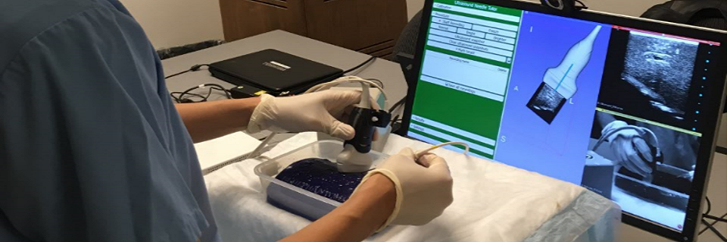
Us-Guided Needle Insertion
Xia et al., SPIE Med Imag, 2018.

Slide 6
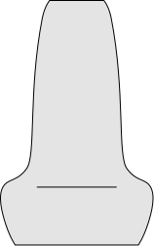
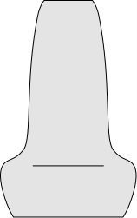
Summary Statistics
Completion time (s)
Probe path (mm)
Needle path (mm)
Needle US plane distance (mm)
Needle US plane angle (°)
Holden et al., IJCARS, 2019.

Slide 7
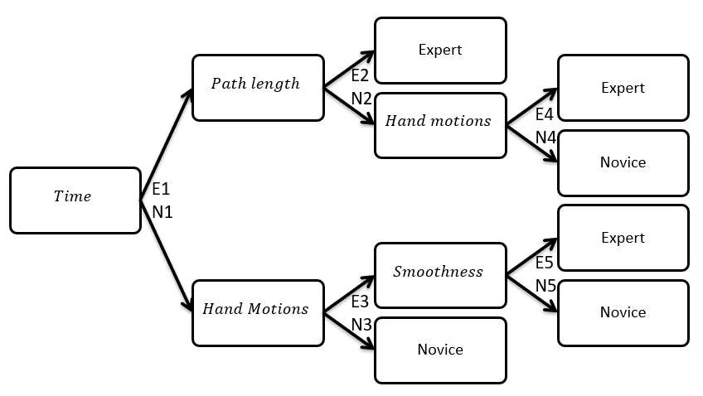
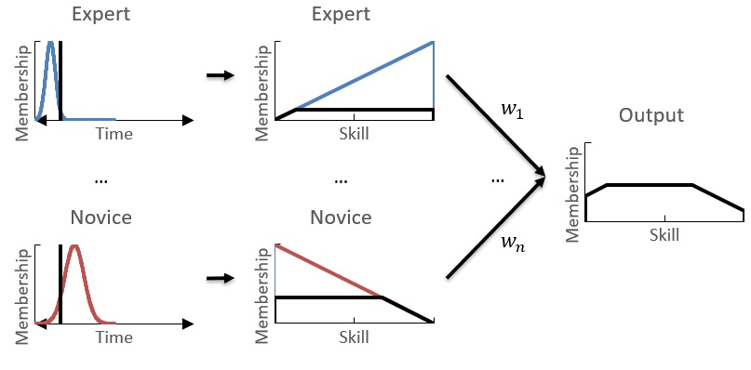
Explainable Assessment
Holden et al., IJCARS, 2019.

Slide 8
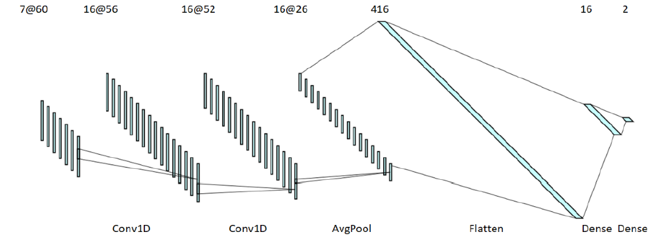
Model Architecture
Liu & Holden, ImNO, 2018.

Slide 9
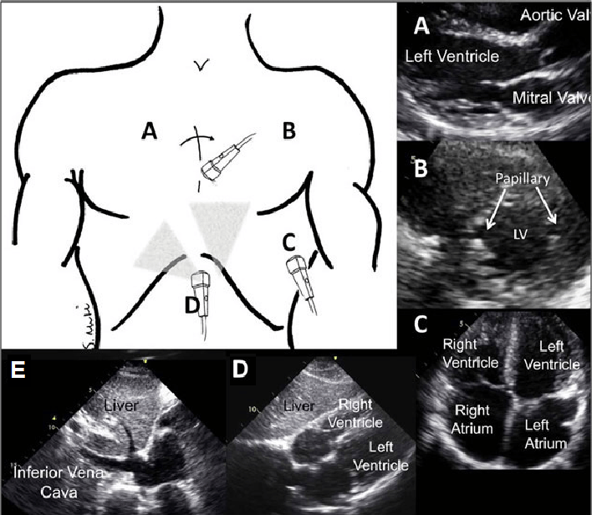
Cardiac Ultrasound
A: Parasternal long axis (PL)
B: Short axis (SA)
C: Apical (AP)
D: Subxyphoid (SX)
E: Inferior Vena Cava (IVC)
Hong et al., J Anesth & Clin Sci, 2015.

Slide 10
Summary Statistics
Completion time (s)
Probe path length (mm)
Probe smoothness (mm/s³)
1
1
2
2
Probe translational actions
Probe rotational actions
Holden et al., UMB, 2021.

Slide 11
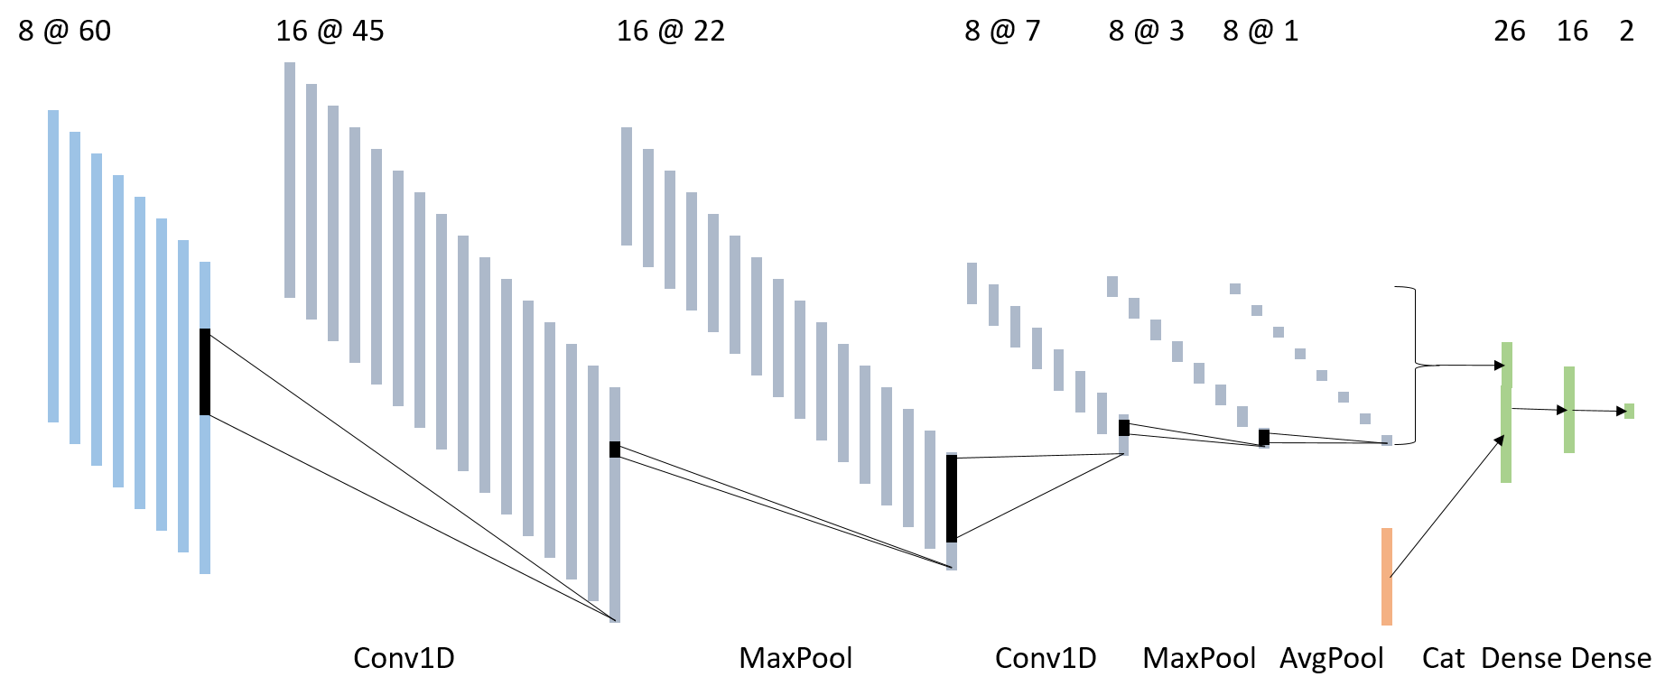
Model Architecture
Holden et al., UMB, 2021.

Slide 12
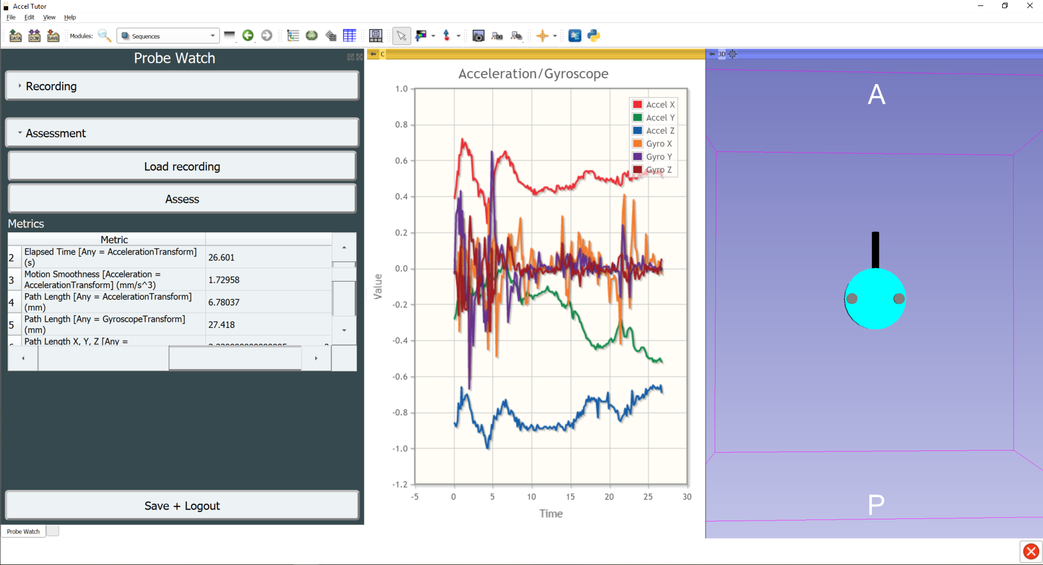
Probe Watch
Holden et al., UMB, 2021.

Slide 13
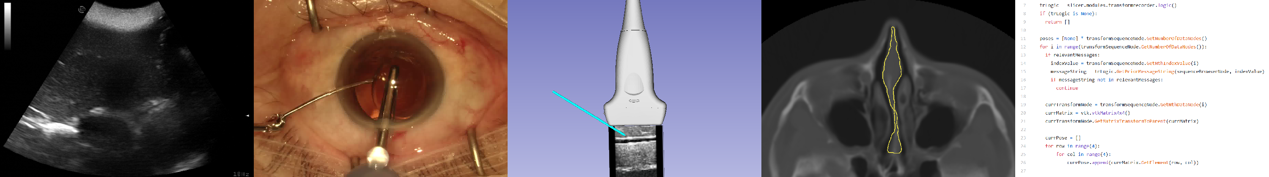
Applications

Slide 14
Thank you
Matthew S. Holden
School of Computer Science
Carleton University
matthew.holden@carleton.ca

